Slide 1

Heart Disease Prediction Using Machine Learning
Internship By : AENEXZ
Presented By: Rithesh D
Department: Data Science and Data Analysis
Technology Used: Python, Machine Learning, Streamlit

Slide 2





Heart Disease Prediction Using Machine Learning
Heart disease is one of the leading causes of death worldwide. Machine Learning helps analyze medical data and predict heart disease risk at an early stage — enabling faster, smarter, and more accurate clinical decisions.
Early Diagnosis
Faster Decisions
Detect risk before symptoms escalate
Accelerate clinical decision-making
Healthcare Support
Reduced Risk
Improved support for medical professionals
Lower medical risk through proactive care

Slide 3
Aim and Objectives
Our Aim
Key Objectives
To compare multiple Machine Learning algorithms and identify the most effective model for heart disease prediction.
01
Analyze the Heart Disease Dataset
02
Perform data preprocessing and visualization
03
Implement Logistic Regression, KNN, and Decision Tree
04
Compare Accuracy and F1-Score
05
Select the best-performing model
06
Develop a Streamlit web application

Slide 4
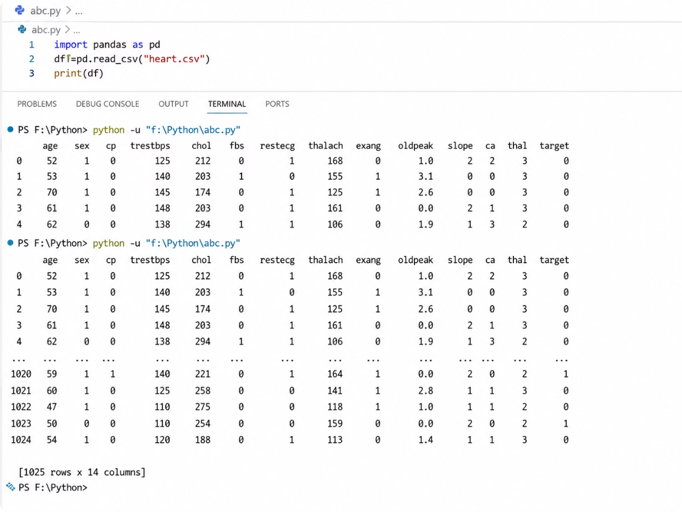
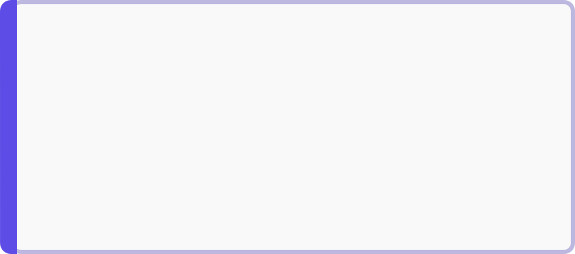

Dataset Description
KAGGLE HEART DISEASE DATASET
Target Variable
Features Used
Age & Gender
Chest Pain
Demographic indicators of patient profile
Type and severity of chest pain reported
Blood Pressure
Cholesterol
Resting blood pressure measurement
Serum cholesterol level in mg/dl
Heart Rate
Exercise Chest Pain
Maximum heart rate achieved
Chest pain induced by exercise
The target variable is binary — making this a classic supervised classification problem suitable for Logistic Regression, KNN, and Decision Tree models.

Slide 5
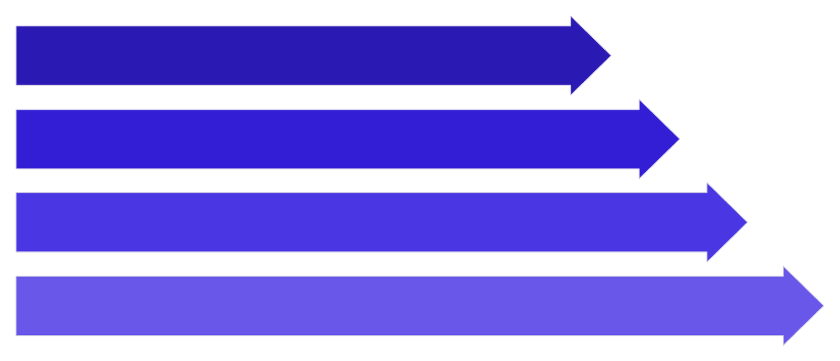

Data Preprocessing
Load Dataset
Check Missing
Feature Select
Train-Test Split
Each step ensures the data is clean, relevant, and properly divided before feeding into machine learning models.
Train-Test Split Code
Preprocessing Summary
import pandas as pd
df = pd.read_csv("heart.csv")
from sklearn.model_selection import train_test_split
X_train, X_test, y_train, y_test = train_test_split(
X, y,
test_size=0.2,
random_state=42
)
80%
20%
Training data
Testing data
No missing values were found in the Kaggle Heart Disease Dataset, simplifying the preprocessing pipeline.

Slide 6
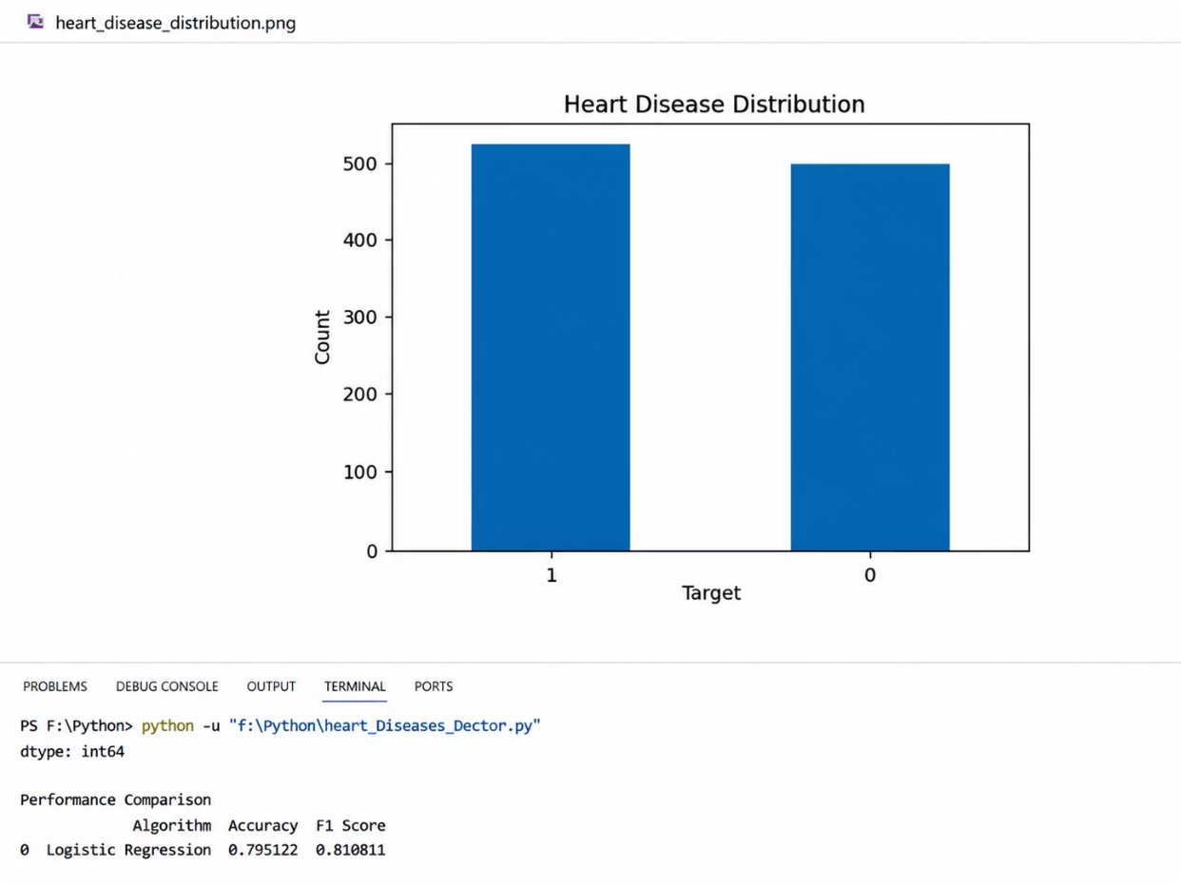
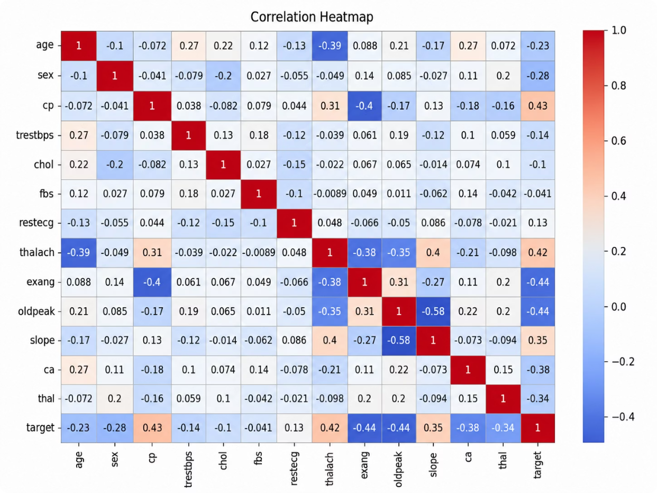

Exploratory Data Analysis
Performed Exploratory Data Analysis to understand data patterns and feature relationships within the Heart Disease Dataset.
heart disease distribution
correction heatmap
Observation: Features such as Chest Pain, Cholesterol, and Heart Rate show significant impact on prediction outcomes and are among the strongest correlating variables in the dataset.

Slide 7



Logistic Regression
Logistic Regression is used for binary classification problems — making it a natural fit for predicting the presence or absence of heart disease.
Advantages
Implementation
from sklearn.linear_model import LogisticRegression
lr = LogisticRegression()
lr.fit(X_train, y_train)
y_pred = lr.predict(X_test)
Simple & Efficient
Minimal computational overhead with strong baseline performance
Fast Training
Converges quickly even on larger datasets
Easy Interpretation
Coefficients directly indicate feature importance

Slide 8

K-Nearest Neighbors (KNN)
The KNN algorithm classifies data based on the nearest neighboring records in the feature space — a non-parametric, instance-based learning approach.
Advantages
Implementation (k=5)
Easy to Implement
from sklearn.neighbors import KNeighborsClassifier
knn = KNeighborsClassifier(n_neighbors=5)
knn.fit(X_train, y_train)
y_pred = knn.predict(X_test)
No explicit training phase required — the model memorizes the training data directly
Effective for Small Datasets
Performs well when the dataset is compact and well-structured like the Heart Disease Dataset
The value n_neighbors=5 means the algorithm considers the 5 closest data points when making a classification decision.

Slide 9



Decision Tree
The Decision Tree algorithm uses a series of decision rules derived from the training data to classify patient records into heart disease or no heart disease categories.
Advantages
Implementation
from sklearn.tree import DecisionTreeClassifier
dt = DecisionTreeClassifier()
dt.fit(X_train, y_train)
y_pred = dt.predict(X_test)
Easy Visualization
High Interpretability
Tree structure can be plotted and inspected directly
Decision rules are human-readable and explainable
Good Prediction
Strong performance on structured tabular data

Slide 10
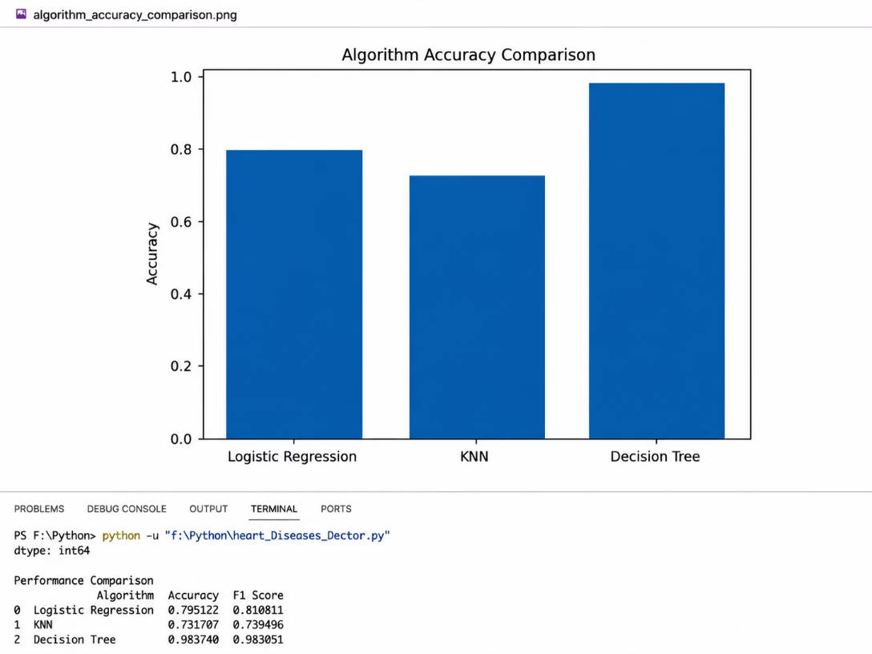
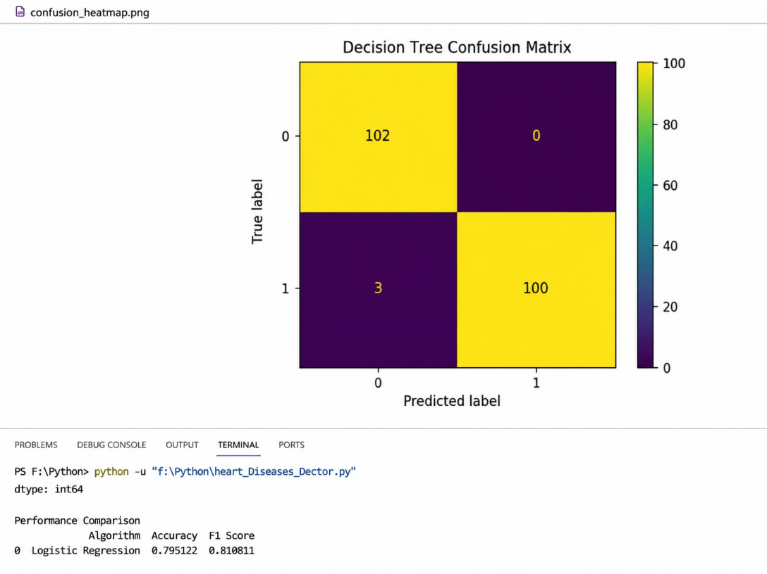

Performance Comparison
Accuracy Comparison of Algorithms
desicion time Confusion Matrix
Results Summary
Algorithm
Accuracy
F1 Score
Logistic Regression
0.795122
0.810811
K-Nearest Neighbors (KNN)
0.731707
0.734300
Decision Tree
0.985366
0.985222
Best Model: The algorithm achieving the highest combined Accuracy and F1 Score will be selected as the final model for deployment in the Streamlit web application.

Slide 11
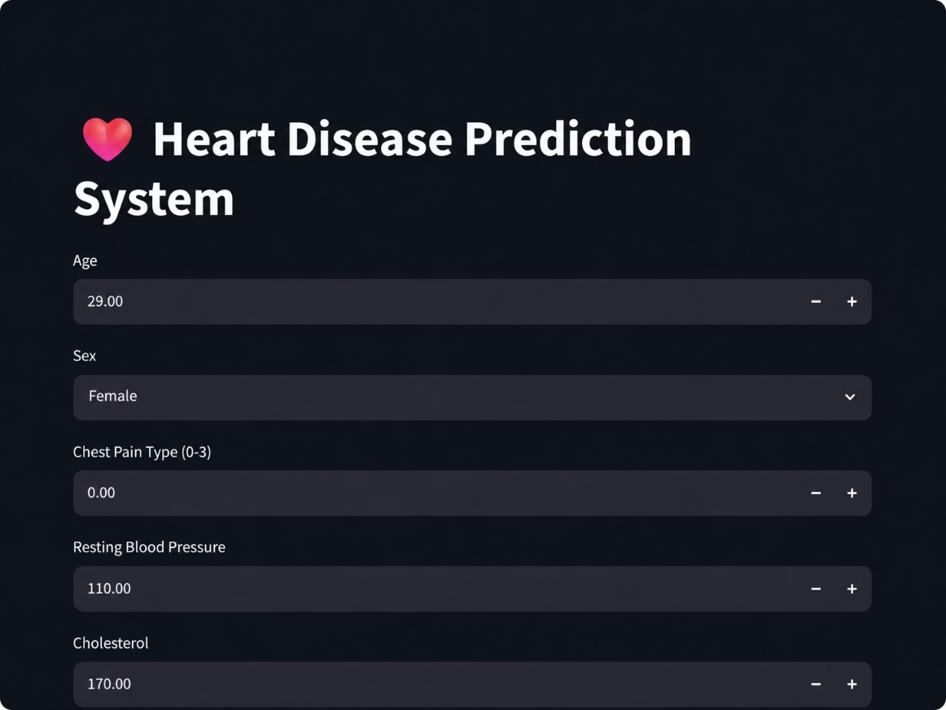
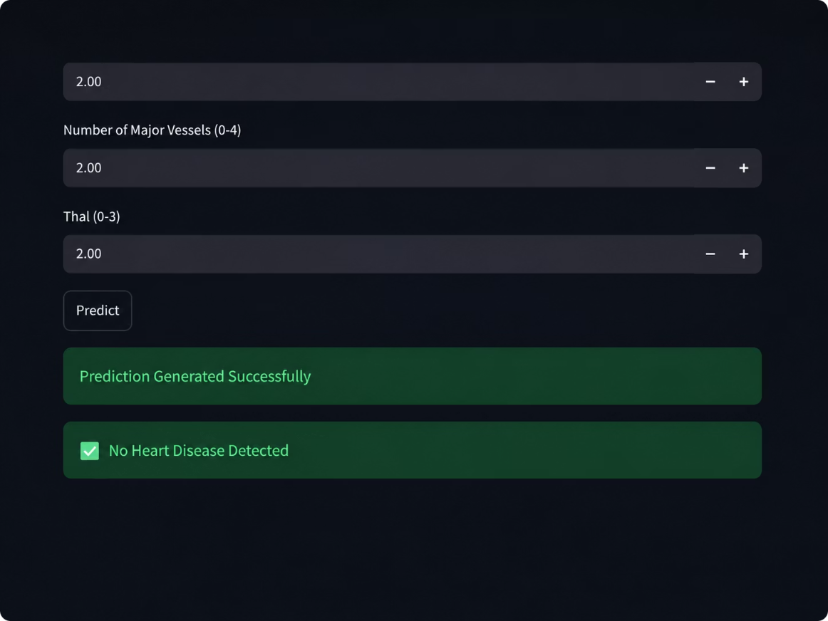


Streamlit Web Application
Heart Disease Prediction System
Developed a Streamlit-based web application for real-time heart disease prediction — enabling clinicians and users to input patient data and receive instant risk assessments.
User-Friendly Interface
Real-Time Prediction
Technologies Used
Clean, intuitive form for entering patient data
Instant results powered by the trained ML model
Streamlit · Python · Scikit-learn ML Model

Slide 12




Conclusion and Future Scope
Our project successfully demonstrated the application of machine learning in predicting heart disease, laying a strong foundation for future advancements.
Key Accomplishments
Future Scope & Directions
Analyzed the Heart Disease Dataset comprehensively
Implemented Logistic Regression, KNN, and Decision Tree models
Compared model performance using Accuracy and F1 Score
Developed a functional Streamlit web application
Selected the best-performing model for deployment
Deep Learning Models
Mobile Application
Develop a mobile app for convenient patient risk assessment
Explore advanced neural networks for improved accuracy
Hospital Integration
Real-Time Monitoring
Integrate the model into existing clinical systems
Enable continuous patient data analysis and alerts

Slide 13

THANK YOU

